Slide 1
Software Training
Computer setup

Slide 2
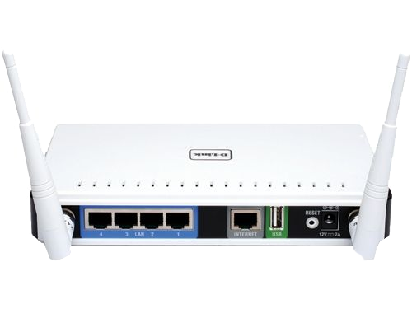
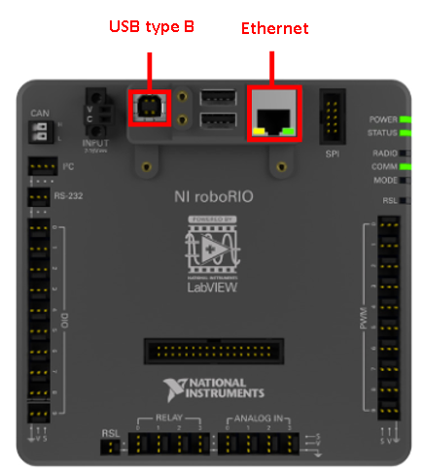
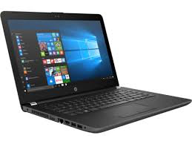
Network
10.25.37.1
10.25.37.5
10.25.37.2

Slide 3
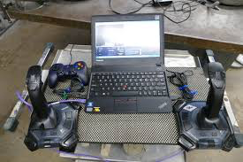
Laptop Setup

Slide 4
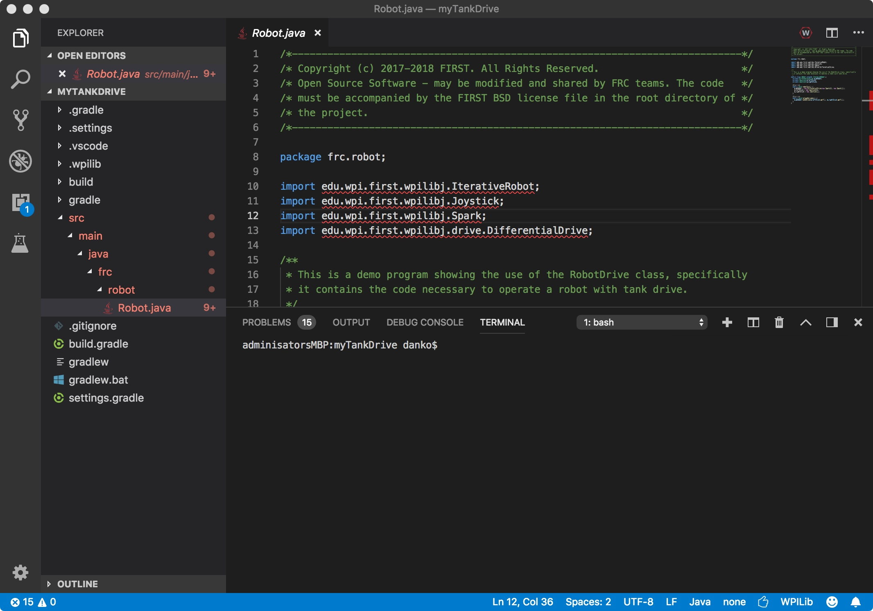
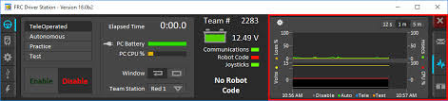
Software Development
VSCODE
10.25.37.2
Drive Station

Slide 5
Java Setup
Install Java – JDK8
https://www.oracle.com/technetwork/java/javase/downloads/jdk8-downloads-2133151.html

Slide 6
VSCODE
Install VSCODE
https://code.visualstudio.com/download
Install WPILib
https://github.com/wpilibsuite/vscode-wpilib/releases
Detailed Instructions:
https://wpilib.screenstepslive.com/s/currentCS/m/79833/l/932382-installing-vs-code

Slide 7
FRC Update Suite
Install FRC 2018 Update Suite
http://www.ni.com/download/first-robotics-software-2015/5112/en/
Instructitions
https://wpilib.screenstepslive.com/s/4485/m/getting_started/l/599670-installing-the-frc-update-suite-all-languages

Slide 8
CTRE Phoenix Framework
http://www.ctr-electronics.com/control-system/hro.html#product_tabs_technical_resources

Slide 9
VSCODE example
Create “RoboticsSoftwareTraining” folder
Create “HelloWorldExample” folder
Start VSCODE
Click on File->New Window
Click on File->Add Folder to Workspace…
Select HelloWorldExample folder
Click on File->New File
Click on File->Save As…
Save file as “HelloWorld.java”

Slide 10
First Java Program
Type in the following into “HelloWorld.java” file
public class HelloWorld {
public static void main(String[] args) {
System.out.println("Hello world");
}
}
Click on File->Save

Slide 11
First Java Program
Click on white triangle at bottom left of VSCODE window (bottom should be blue)
Click on Terminal
Type “ls”
Should see list of files in folder “Hello World.java”
Type “javac HelloWorld.java”
Should just see command prompt
Type “java HelloWorld”
Should see “Hello Word”
Click on “Run” in edit window
Click on “Debug console”
Should see “hello world”

Slide 12
Display 10 Hello Worlds
Edit the “HelloWorld.java” program
Use “for” loop as follows
Compile and run program

